Slide 1
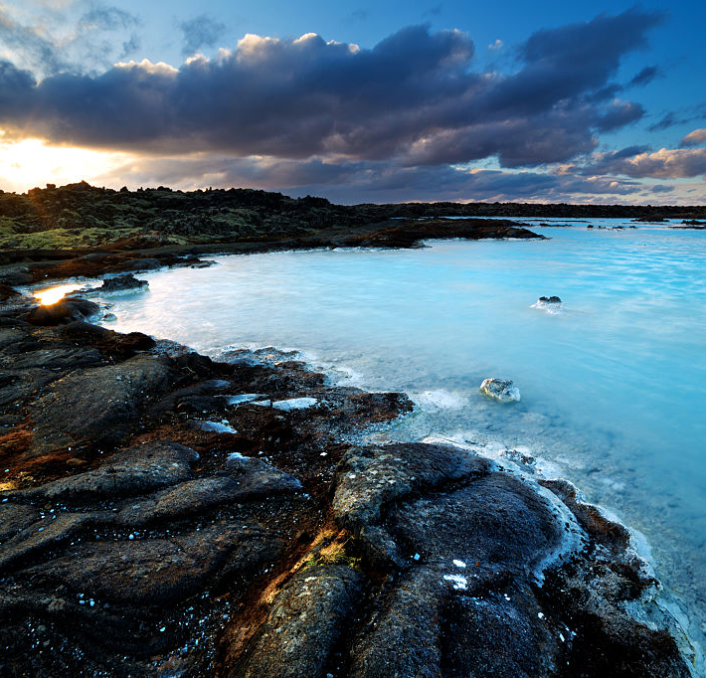

Cutting fossil carbon to meet climate goals
Galen A McKinley
Professor of Earth and Environmental Science
Columbia University
Lamont Doherty Earth Observatory
23 February 2021

Slide 2
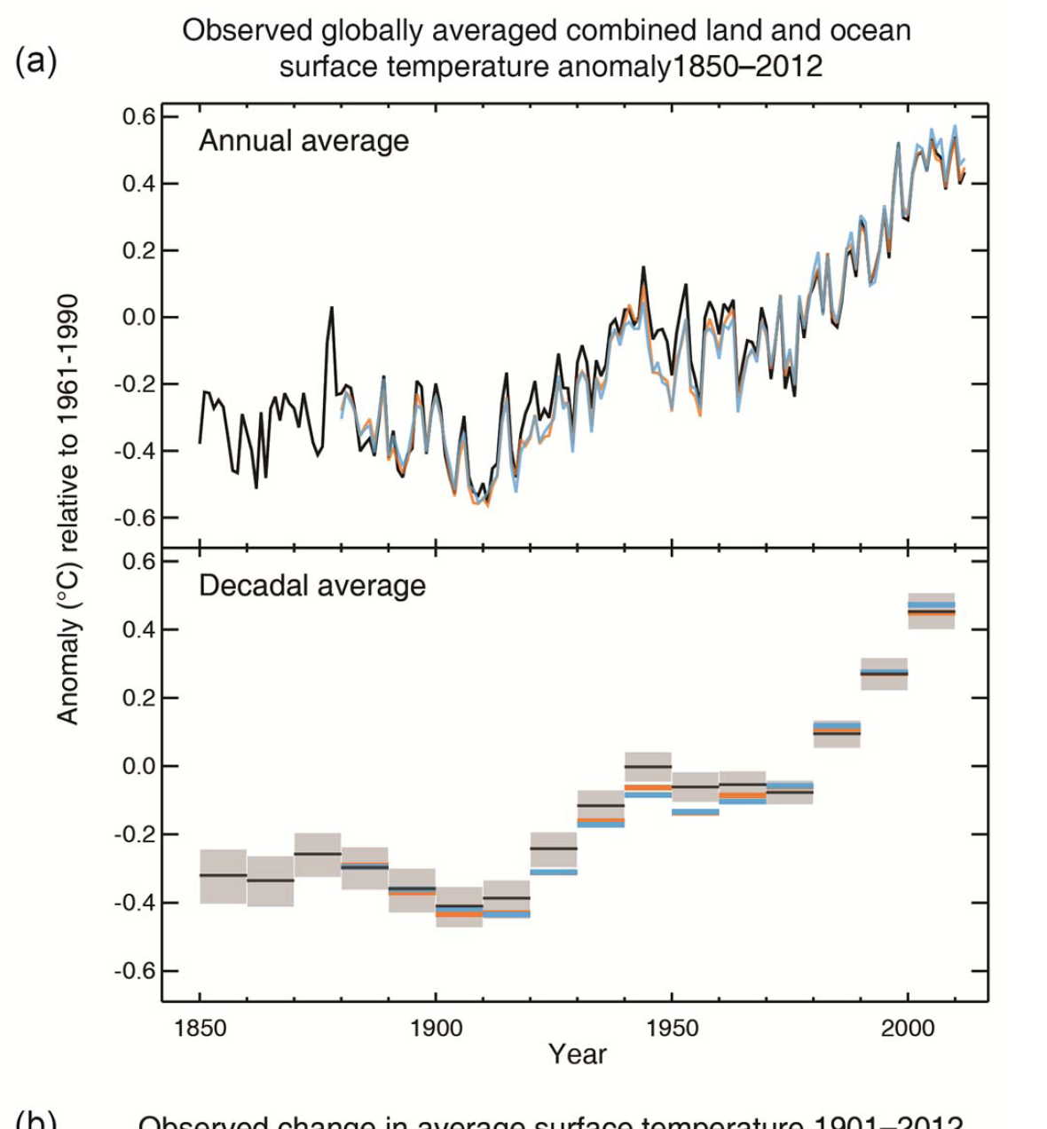
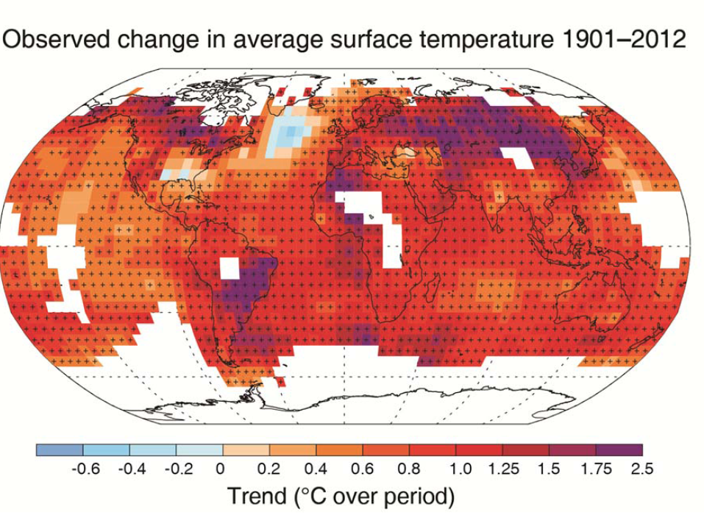
Climate Change is now
Global Temperature Anomaly 1850-2012
“The globally averaged combined land and ocean surface temperature data .. show a warming of 0.85 [0.65 to 1.06]°C, over the period 1880–2012” IPCC AR5 WG1 2013
IPCC AR5 WG1 Figure SPM.1

Slide 3
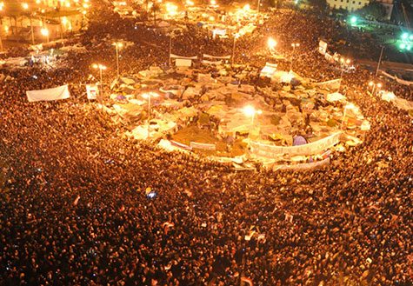
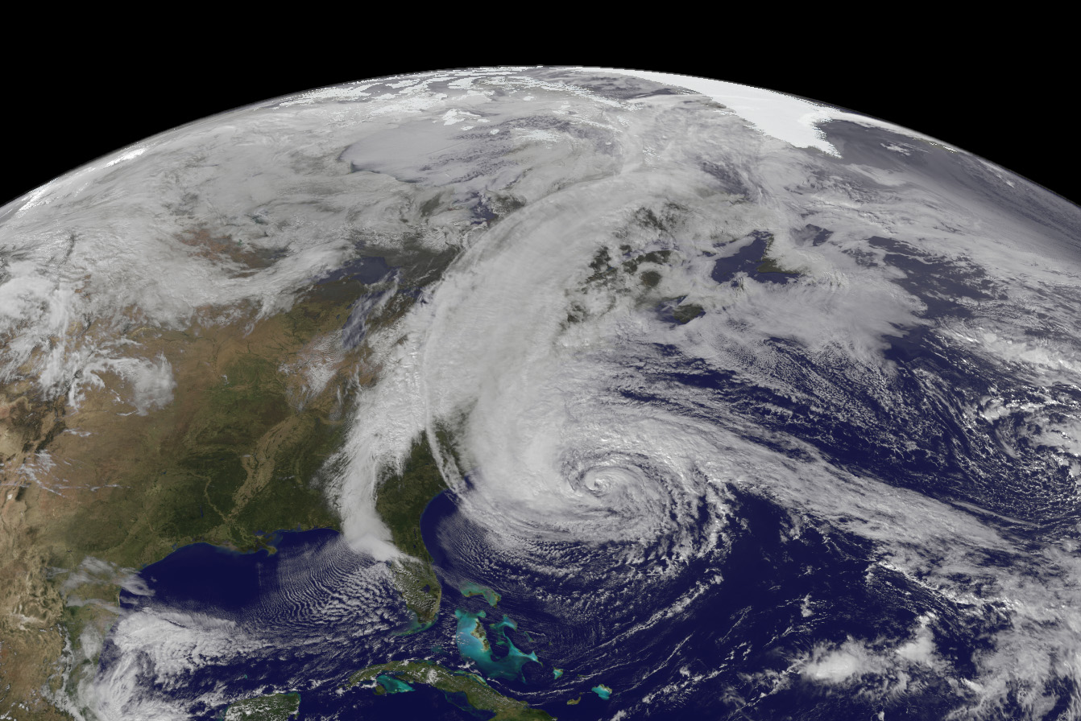
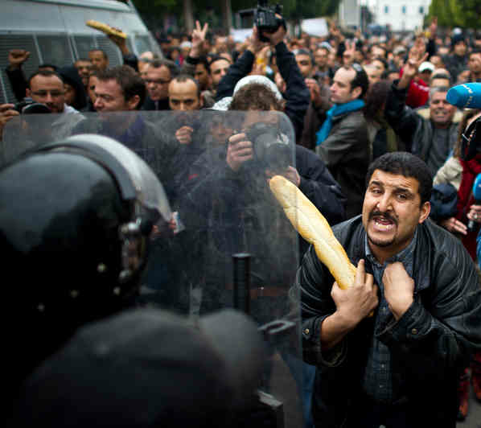
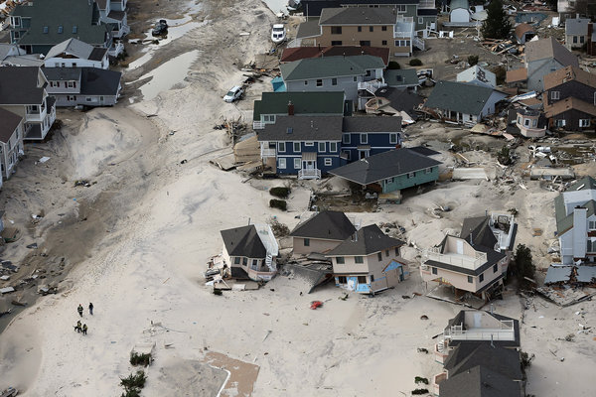
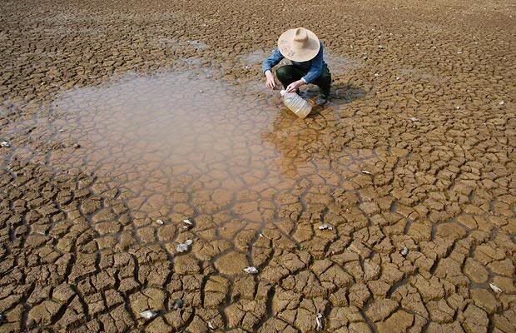
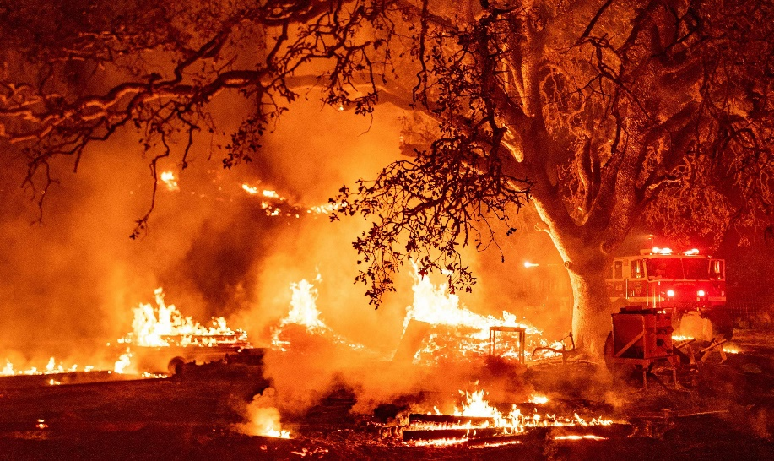

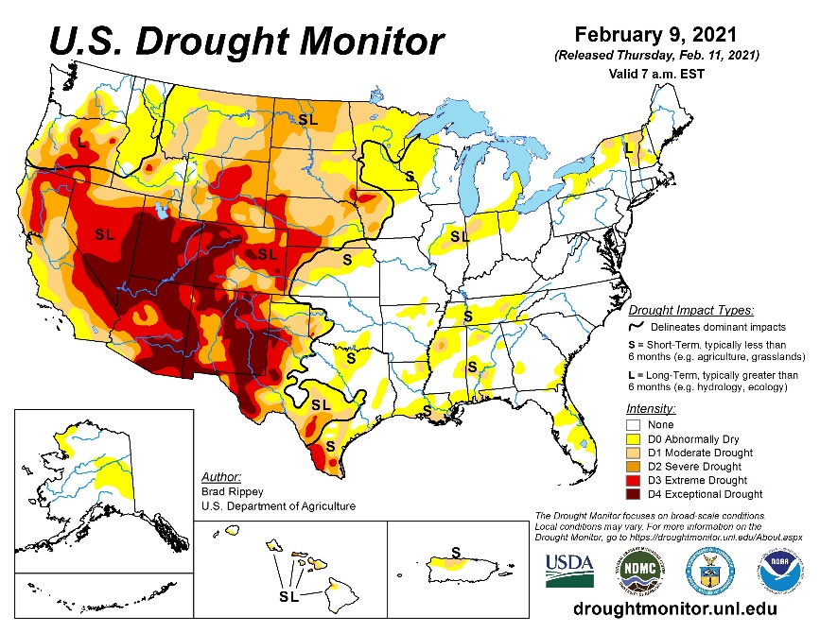
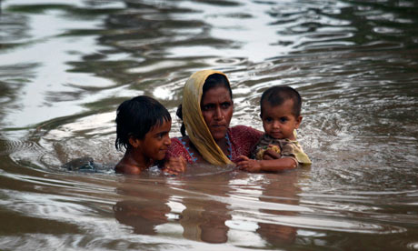
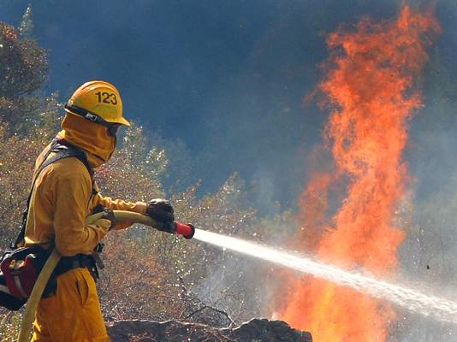
Climate impacts demand a response
Sandy, 2012
Glass Fire, CA 2020
Arab Spring, 2011
Pakistan, 2010

Slide 4
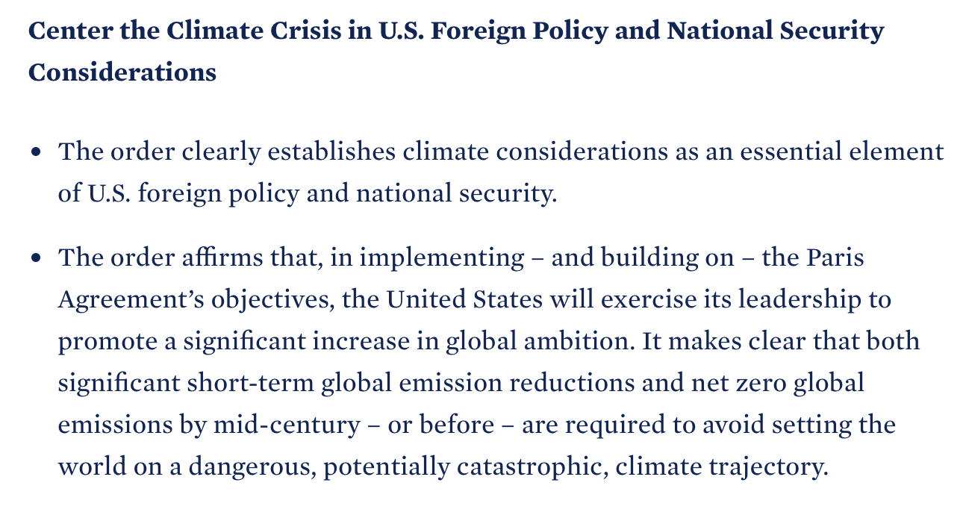
Climate impacts demand a response
Executive Order on the Climate Crisis, President Biden
27 January 2021
Sandy, 2012
Glass Fire, CA 2020
Arab Spring, 2011
Pakistan, 2010

Slide 5
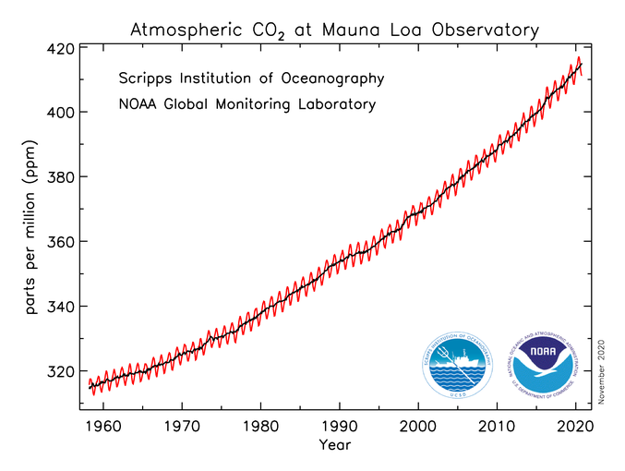
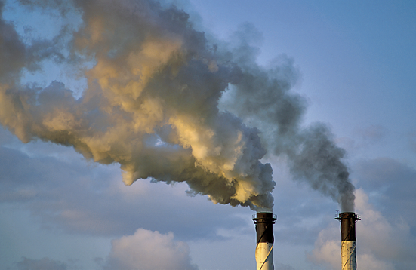
Warming is primarily (~80%) due to CO₂ accumulation in the atmosphere, in turn driven by anthropogenic emissions
CO₂

Slide 6

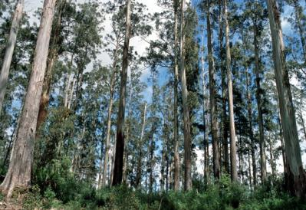
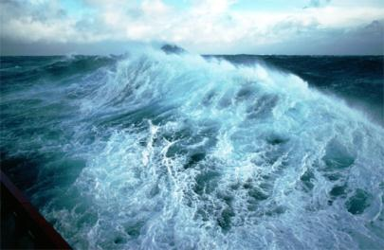
Our carbon doesn’t all remain in the atmosphere
Atmosphere
Fossil Fuels
Land Biosphere
Ocean

Slide 7
Global CO₂ sources and sinks

Slide 8
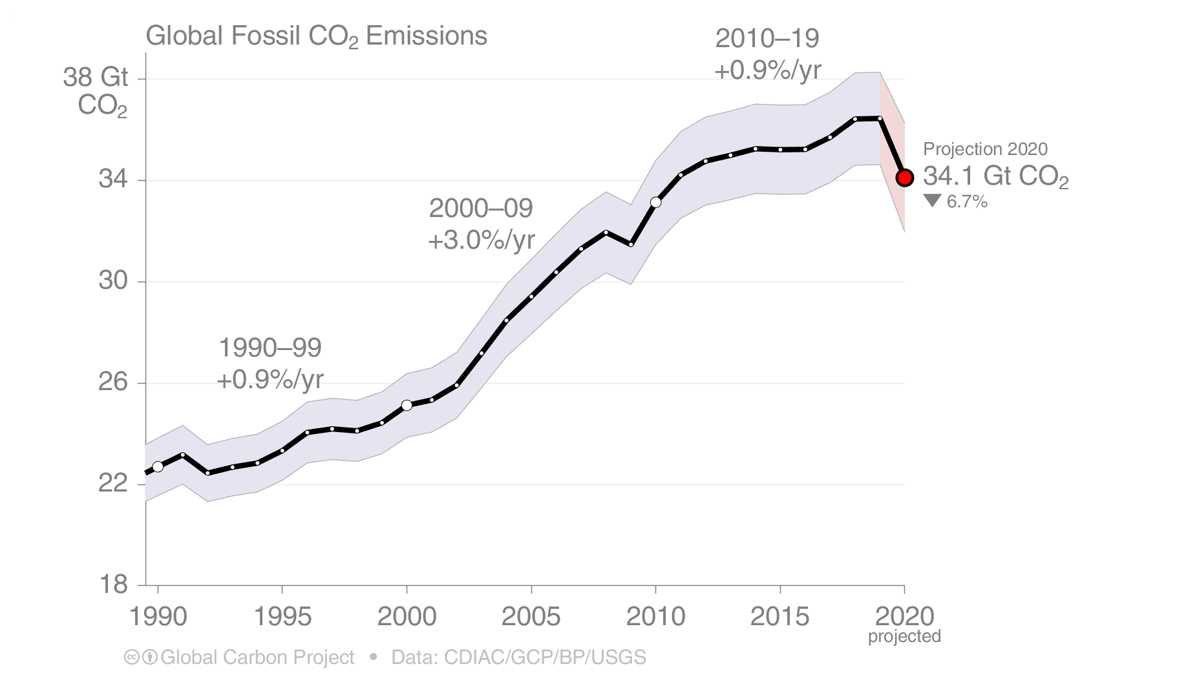
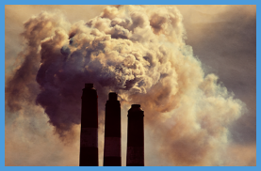
Global Fossil CO₂ Emissions (1990-2019 + projection for 2020)
Global fossil CO₂ emissions: 36.4 ± 2 GtCO₂ in 2019, 61% over 1990
Projection for 2020: 34.1 ± 2 GtCO2, about 7% lower than 2019
Significant COVID-19 impacts projected for 2020
Uncertainty is ±5% for one standard deviation (IPCC “likely” range)
The 2020 projection is based on preliminary data and modelling, and is the median of the four studies.
Source: CDIAC; Friedlingstein et al 2020; Global Carbon Budget 2020

Slide 9
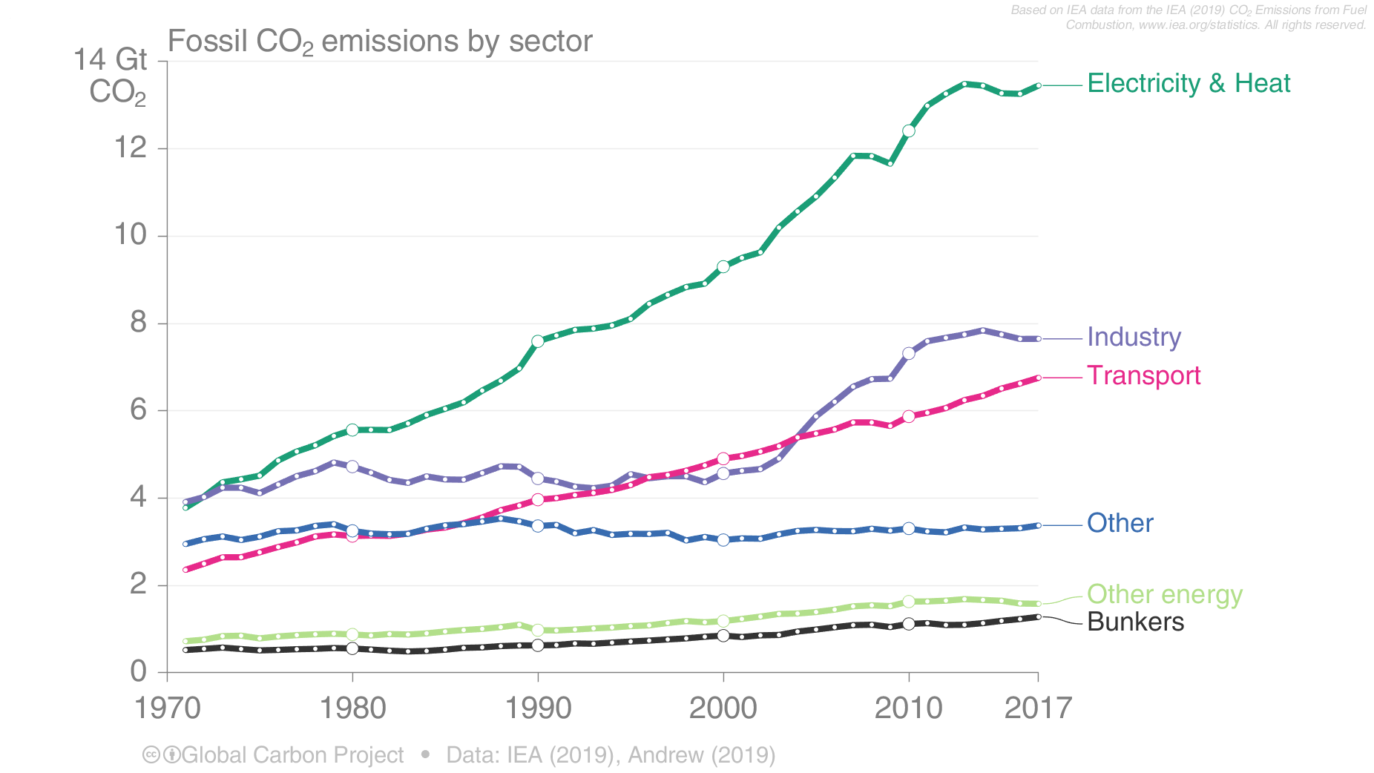
Fossil CO₂ Emissions by Sector (1970-2017)
Global fossil CO₂ emissions are dominated by electricity, heat, & energy (45%), industry (23%), & national transport (19%).
International aviation and marine bunkers are 3.5% & remaining sectors 10%.
Source: IEA 2019; Peters et al 2019; Global Carbon Budget 2019

Slide 10
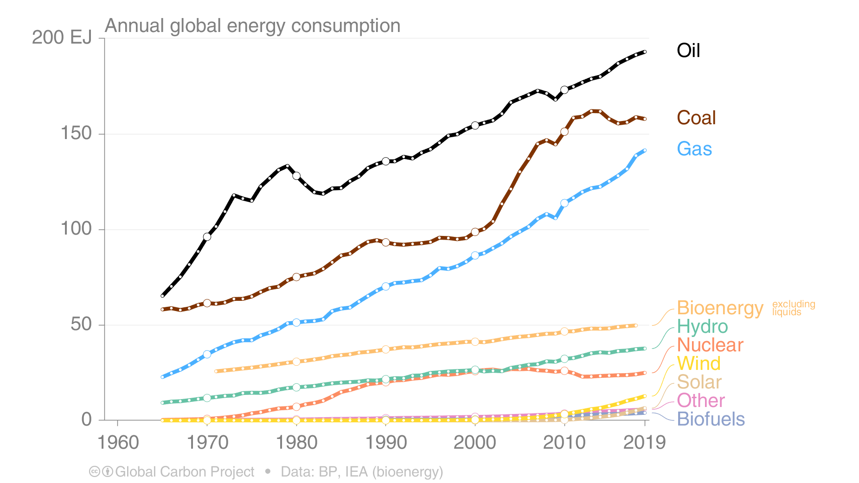
Energy Use by Source (1965-2019)
Renewable energy is growing exponentially, but this growth has so far been too low
to offset the growth in fossil energy consumption.
This figure shows “primary energy” using the BP substitution method
(non-fossil sources are scaled up by an assumed fossil efficiency of 0.38)
Source: BP 2020; Global Carbon Budget 2020

Slide 11
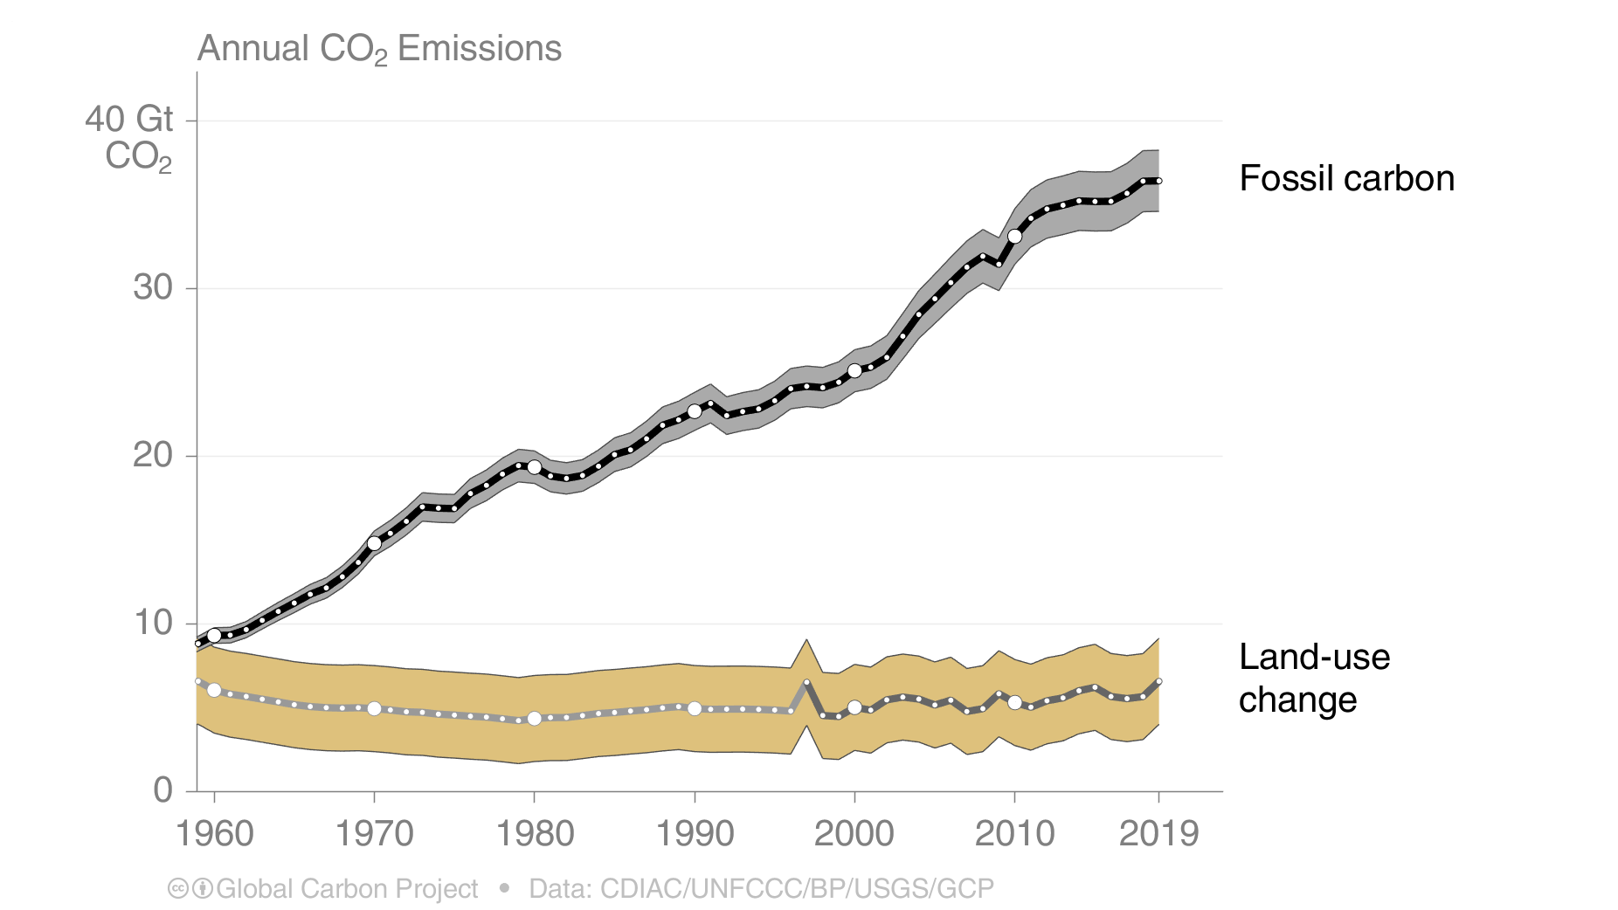
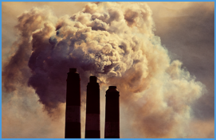
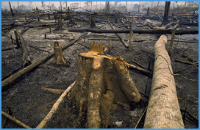
Total CO₂ Emissions (1958-2019)
Total global emissions: 43.0 ± 3.3 GtCO₂ in 2019, 56% over 1990
Percentage land-use change: 39% in 1960, 14% averaged 2010–2019
Land-use change estimates from three bookkeeping models, using fire-based variability from 1997
Source: CDIAC; Houghton and Nassikas 2017; Hansis et al 2015; Gasser et al 2020; van der Werf et al. 2017;
Friedlingstein et al 2020; Global Carbon Budget 2020

Slide 12

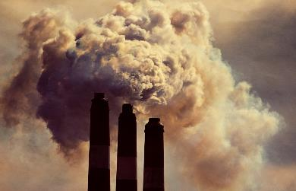
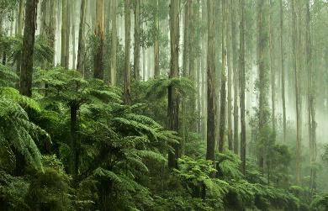
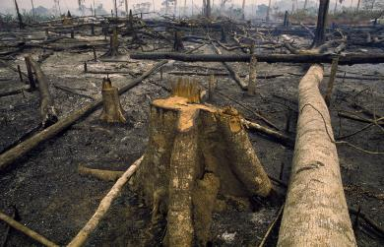
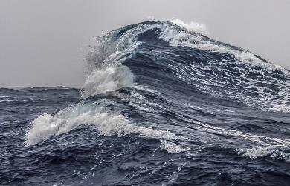
CO₂ sources and sinks (2010–2019 average)
Sources = Sinks
18.6 GtCO₂/yr
46%
34.4 GtCO₂/yr
86%
31%
12.5 GtCO₂/yr
14%
5.7 GtCO₂/yr
23%
9.2 GtCO₂/yr
Budget Imbalance:
(the difference between estimated sources & sinks)
0.4%
0.2 GtCO₂/yr
Source: Friedlingstein et al 2020; Global Carbon Budget 2020

Slide 13
Land Sink, much due to forests growing more than deforestation
…. strong now, but warming will reduce
intact forest uptake
uptake by previously
cut forests
deforestation source
Pan et al. 2011, Science
Notes:
Net sinks point down, net source up
”Forest carbon flux” is INTACT forests growing better with more CO2, warming
“Regrowth” is recovery from disturbance

Slide 14
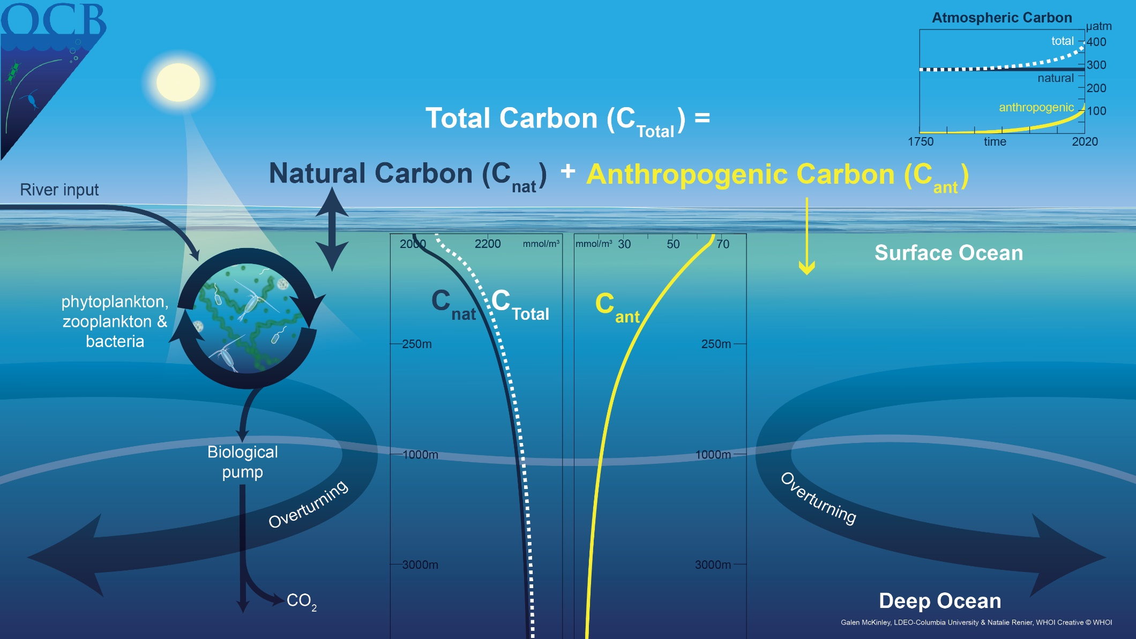
Ocean uptake due to rising atmosphere CO₂, on top of strong natural cycle
…this will slow proportional to slowing atmospheric growth

Slide 15
Future emissions to achieve climate goals?

Slide 16
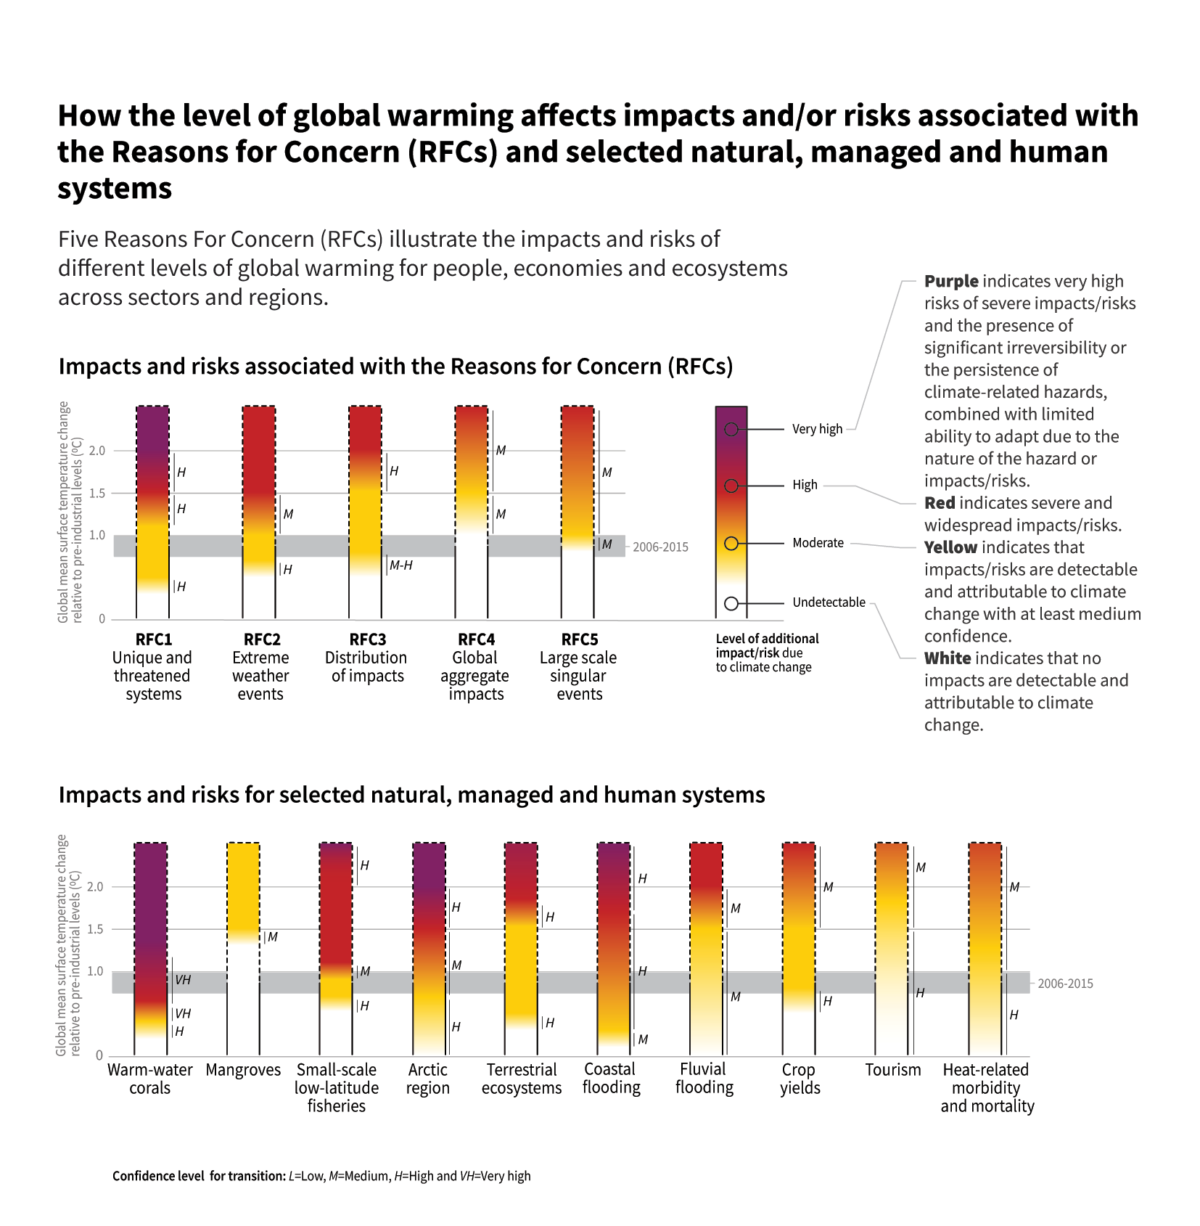

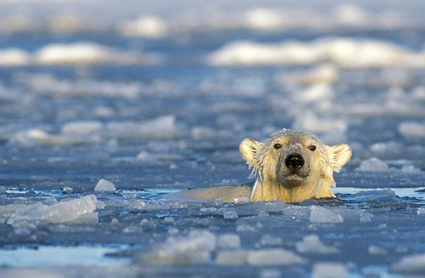
Avoid severe impacts by limiting warming to 1.5C
IPCC SR1.5 Figure SPM.2

Slide 17
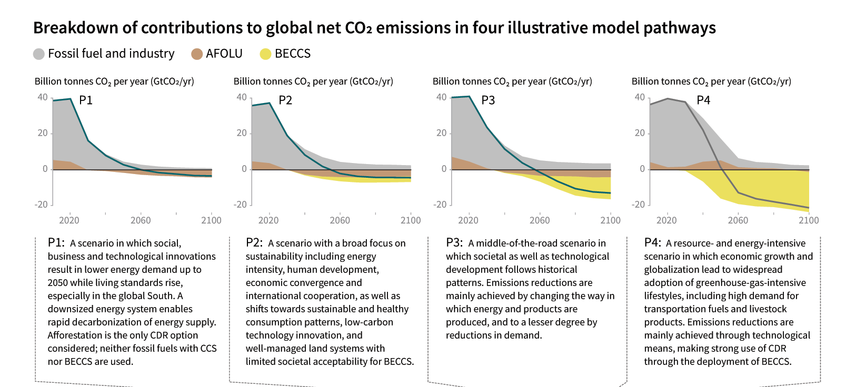
Fossil fuel emissions must be dramatically cut to get to 1.5ºC
IPCC SR1.5 Figure SPM.3

Slide 18
Fossil fuel emissions must be dramatically cut to get to 1.5ºC
It is not clear that “Negative Emissions” of this enormous magnitude are feasible (technology, cost, ecological, land use…)
IPCC SR1.5 Figure SPM.3

Slide 19
Fossil fuel emissions must be dramatically cut to get to 1.5ºC
All scenarios require dramatic reductions of fossil emissions in the coming decades
IPCC SR1.5 Figure SPM.3

Slide 20
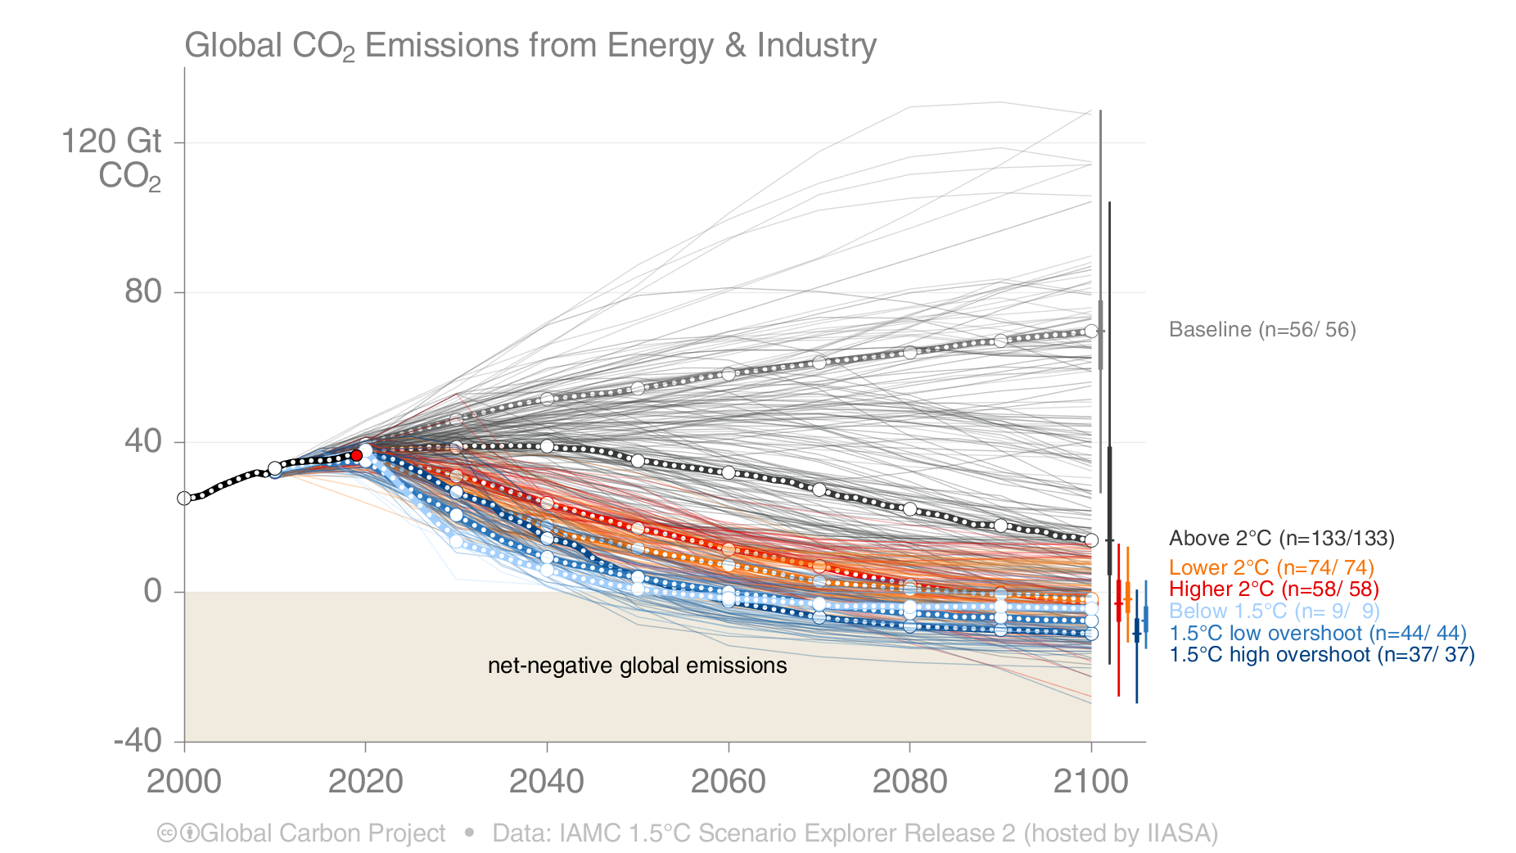
The IPCC Special Report on “Global Warming of 1.5°C”
The IPCC Special Report on “Global Warming of 1.5°C” presented new scenarios:
1.5°C scenarios generally require halving emissions by ~2030, net-zero by ~2050, and negative thereafter
Net emissions include those from bioenergy with carbon capture and storage (BECCS).
Source: Huppmann et al 2018; IAMC 1.5C Scenario Database; IPCC SR15; Global Carbon Budget 2019

Slide 21
The IPCC Special Report on “Global Warming of 1.5°C”
Achieving 1.5ºC requires radical cuts in fossil CO₂ emissions in the immediate future
2019
Net emissions include those from bioenergy with carbon capture and storage (BECCS).
Source: Huppmann et al 2018; IAMC 1.5C Scenario Database; IPCC SR15; Global Carbon Budget 2019

Slide 22



THANK YOU mckinley@ldeo.columbia.edu

